Slide 1


Fusion 360
Aeromodelling Club IIT Kanpur
Project Mentors:- Mohit Anand Raj Agarwal Pranshu Singhal

Slide 2



TASKS TO BE PERFORMED
DESIGN
BUILD
FLY

Slide 3
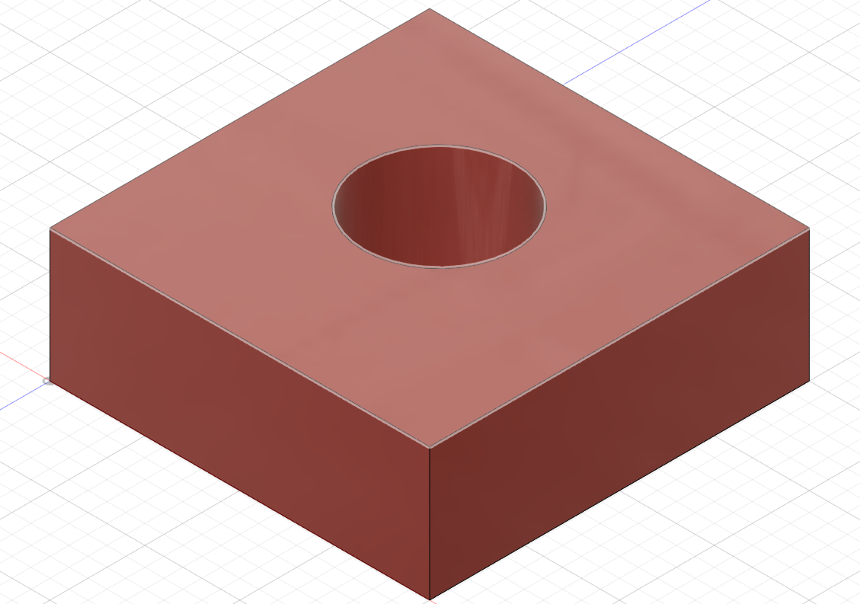
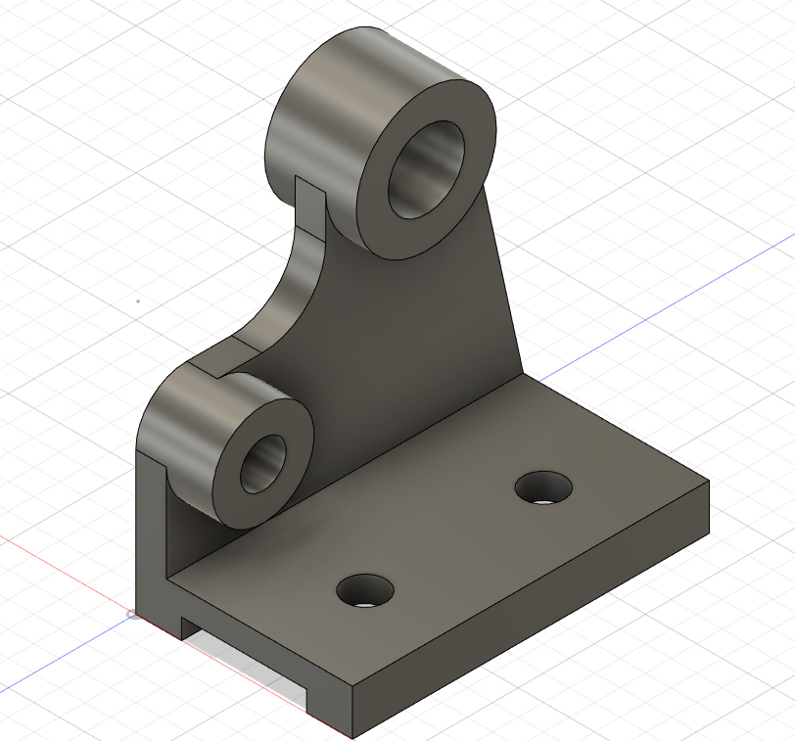
TOPICS COVERED TILL NOW
Introduction, Avionics, Types of aircrafts, Terminologies, Installing Fusion 360, Basic functionalities in Fusion 360
2D sketching, converting 2D sketch to 3D model
Getting used to different tools and different features in 3D modelling, In depth 3D modelling

Slide 4
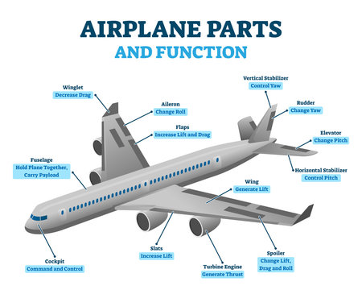
Basics of
Aeromodelling
Various parts of a plane:-
Wing
Aileron
Rudder
Elevators
Cockpit
Fuselage
Flaps
Slats

Slide 5
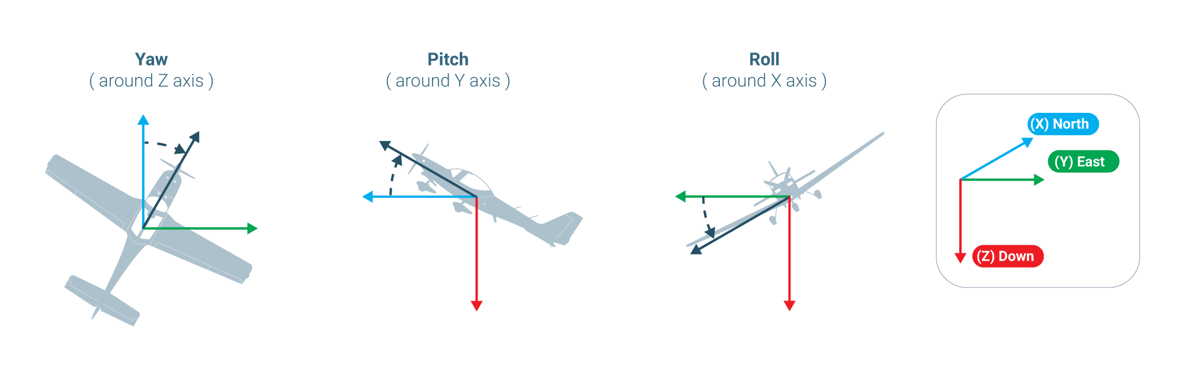
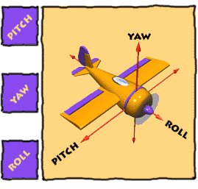
Pitching, Rolling and Yawing motion

Slide 6
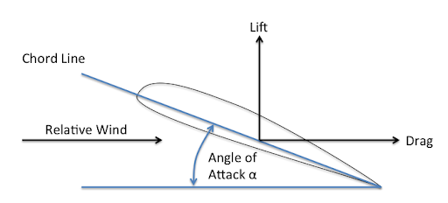
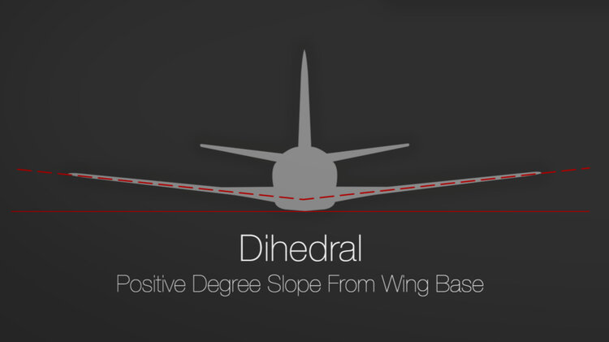
Types of angles in a plane

Slide 7
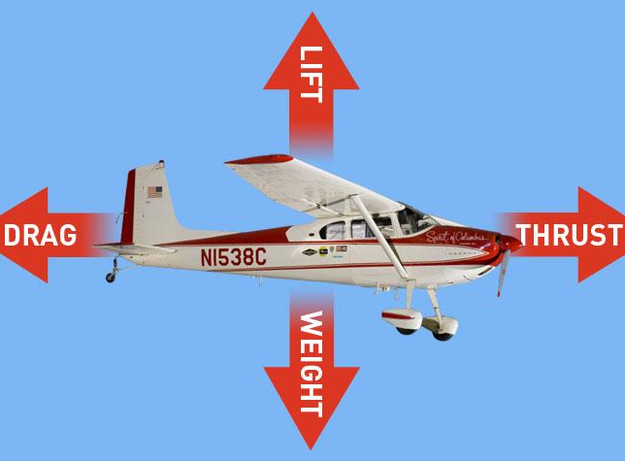
Forces acting on an aircraft
Lift
Weight
Thrust
Drag

Slide 8
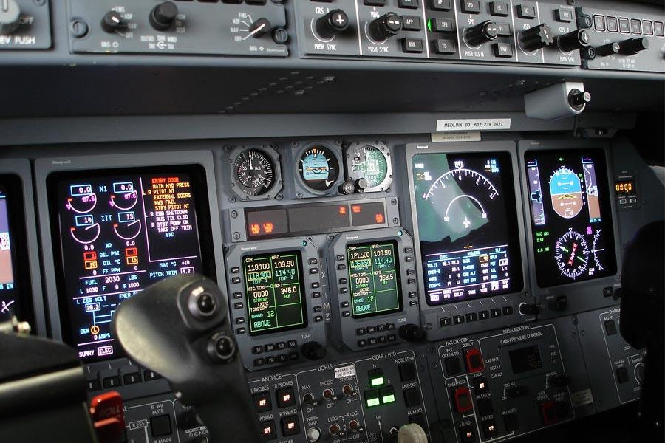
AVIONICS
Avionics are the electronic systems used on aircraft, artificial satellites, and spacecraft. Avionic systems include communications, navigation, the display and management of multiple systems, and the hundreds of systems that are fitted to aircraft to perform individual functions.
SUBSYSTEMS OF AVIONICS:
Communications
Radio Telemetry
Radio Transmitter
Radio Receiver
Navigation
GPS
Compass
Aircraft Flight-Control System
Autopilot
IMU
Onboard Processor
Black Boxes

Slide 9
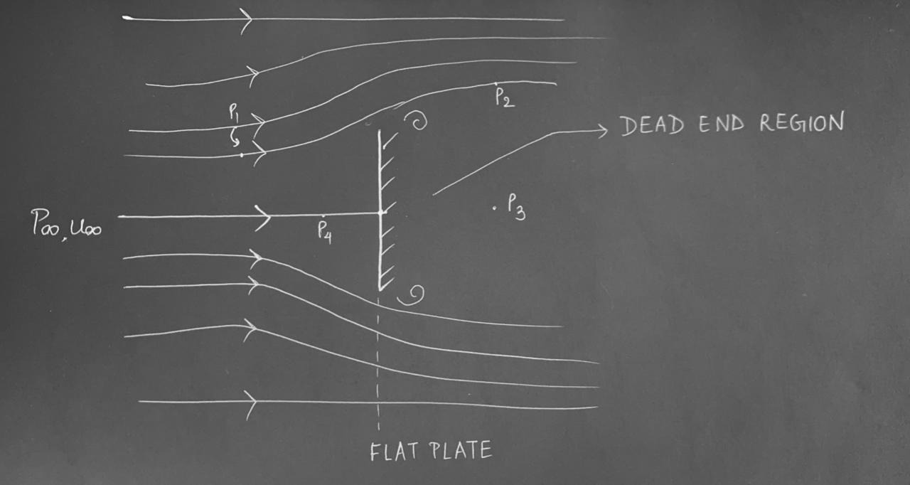
BASIC CONCEPT OF PRESSURE DRAG
USING BERNOULLI EQUATIONS,
P4>P∞ (Since point 4 is nearer to stagnation point)
P1≈ P∞ ( nearly undeflected)
P2≈ P1 ( nearly undeflected)
P2≈ P3( due to wake)
CONCLUSION : P4>P3
which causes pressure drag.
Here, Pi are pressures at different points of the streamline flow.

Slide 10
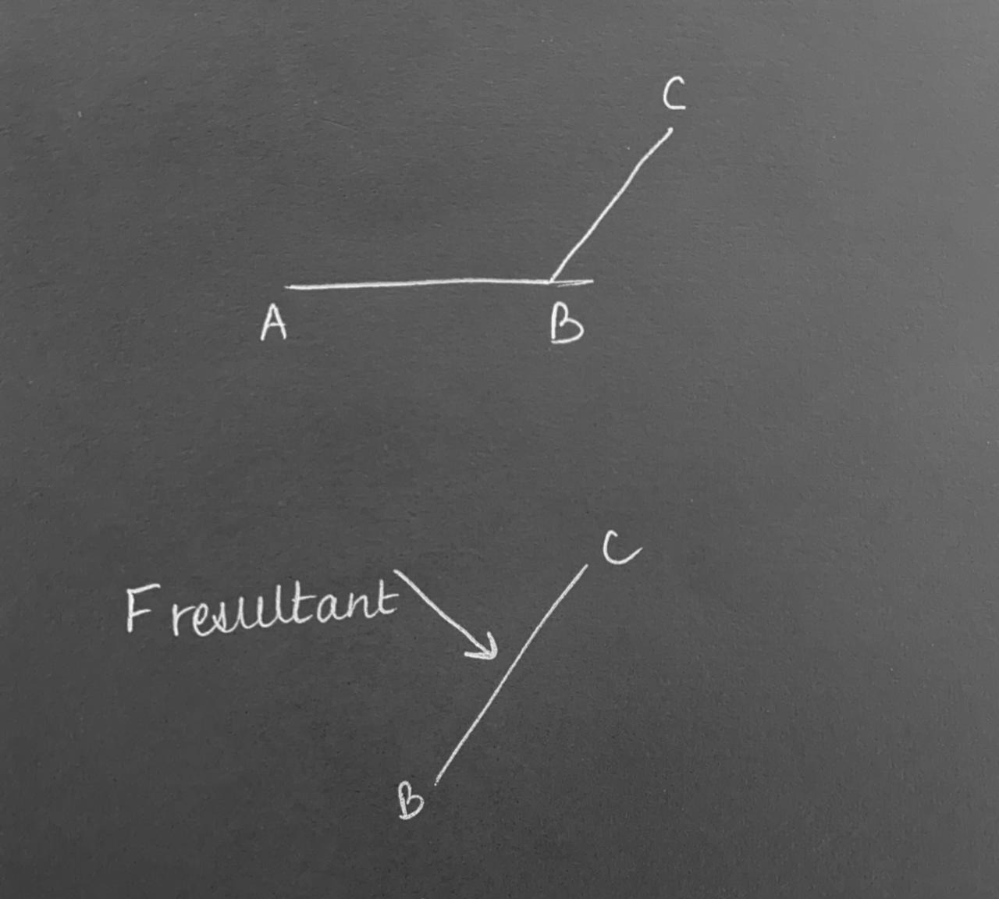
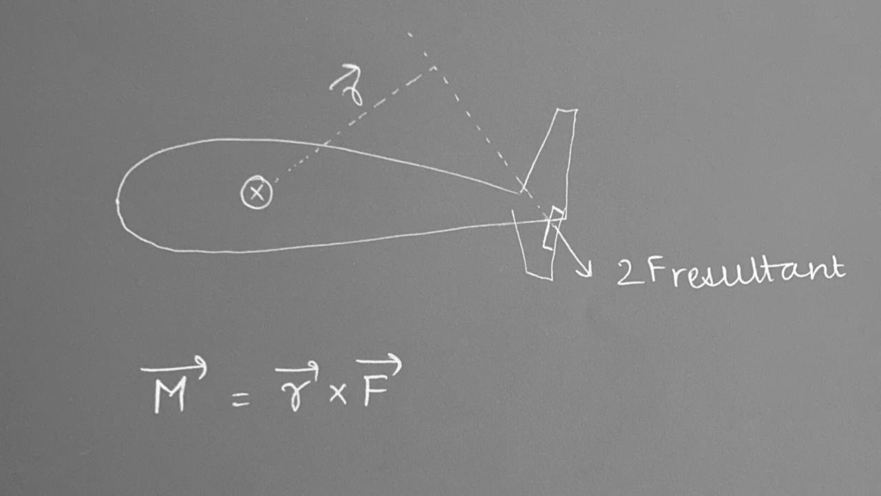
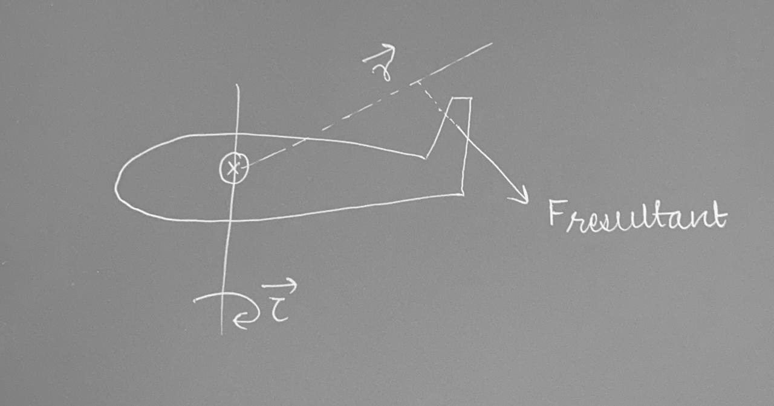
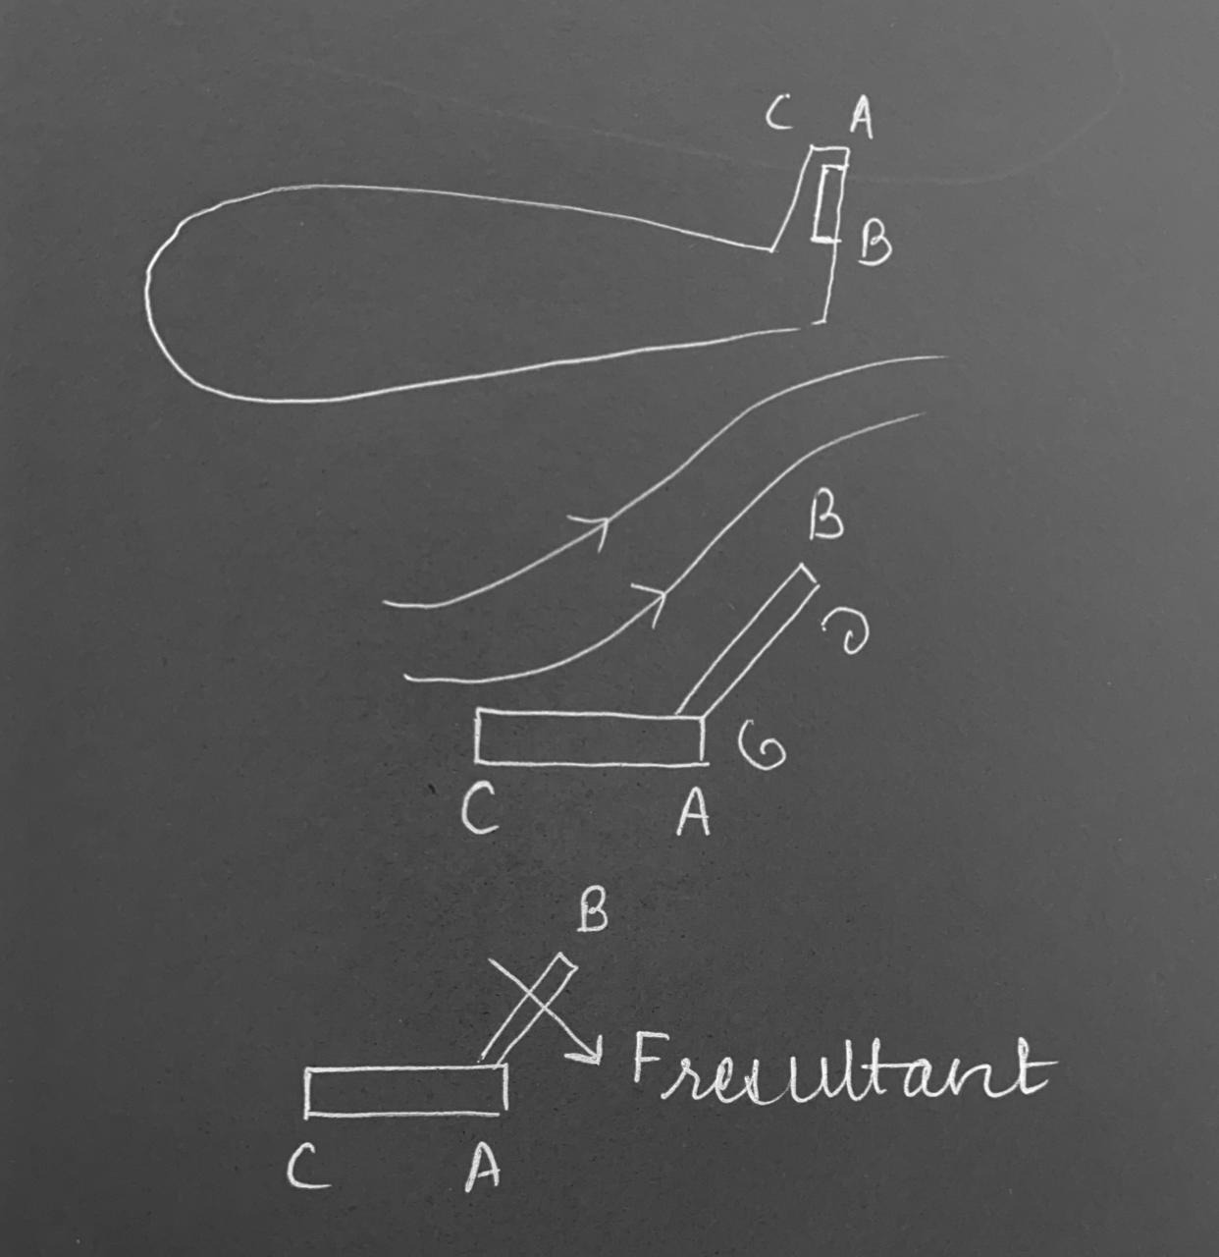
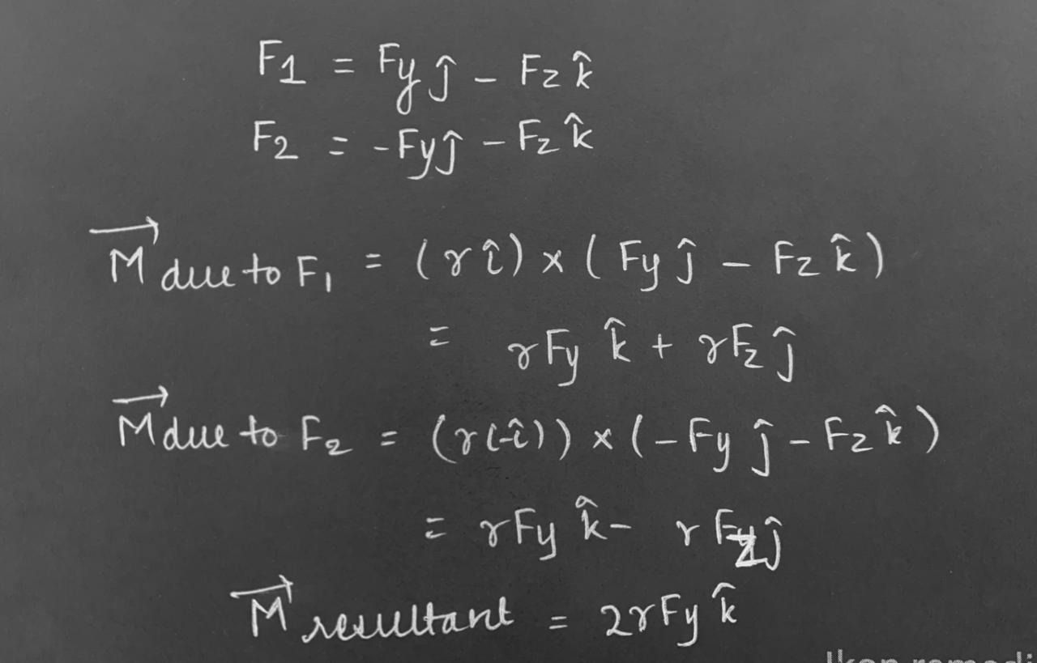
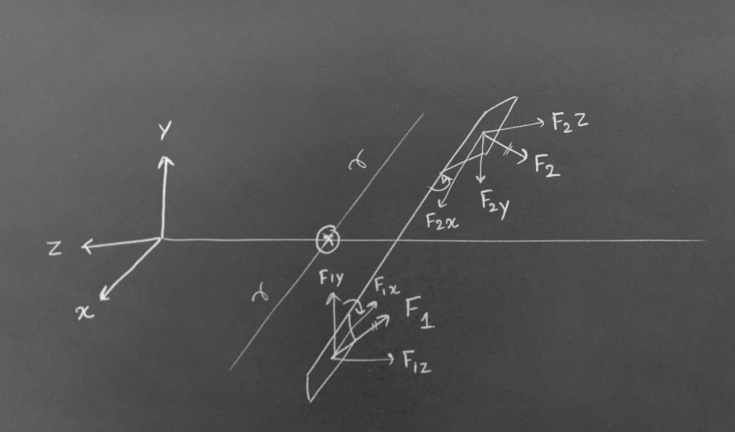
WORKING OF ELEVATOR IN PITCHING MOTION
BASIC PHYSICS INVOLVED IN FLYING
Here B-C are Elevators, which produces a resultant force due to pressure difference.This resultant force produces a torque which produces the pitch motion
WORKING OF A RUDDER IN YAWING MOTION
Here,AB indicated are rudders on vertical stabilizers and again due to pressure difference resultant force is produced which results in torque.
WORKING OF AILERONS IN PRODUCING ROLLING MOTION
Here, two ailerons are indicated and if one aileron goes in one direction the other goes in the opposite direction.Moreover no torque is produced due to x components of the resultant forces.

Slide 11
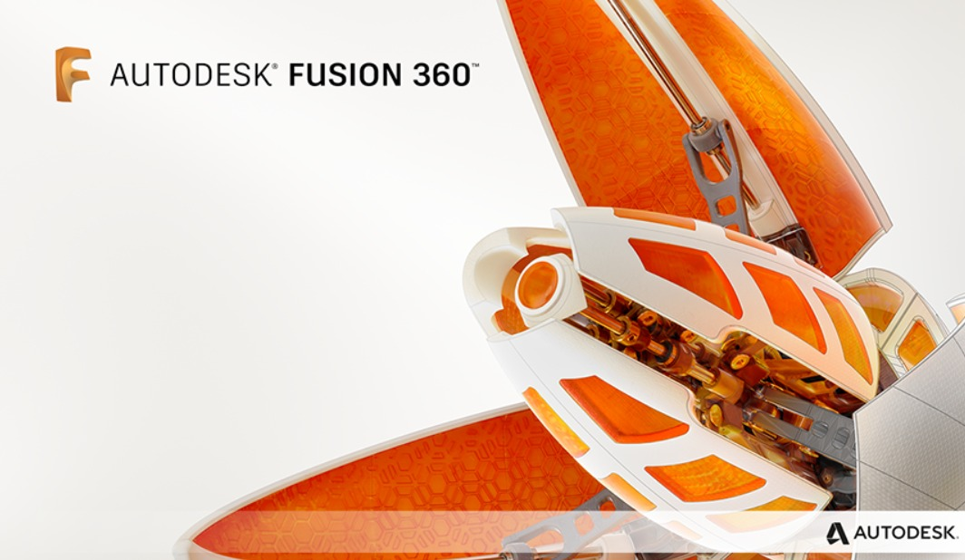
Installing Fusion 360 for personal use
Visit “Autodesk Fusion 360”
Find and click on “Personal use”
Click on “Get started”
Fill up the email and other required details
Create an account
click on the “download link”
Install to your device.
Login with details
Start sketching

Slide 12
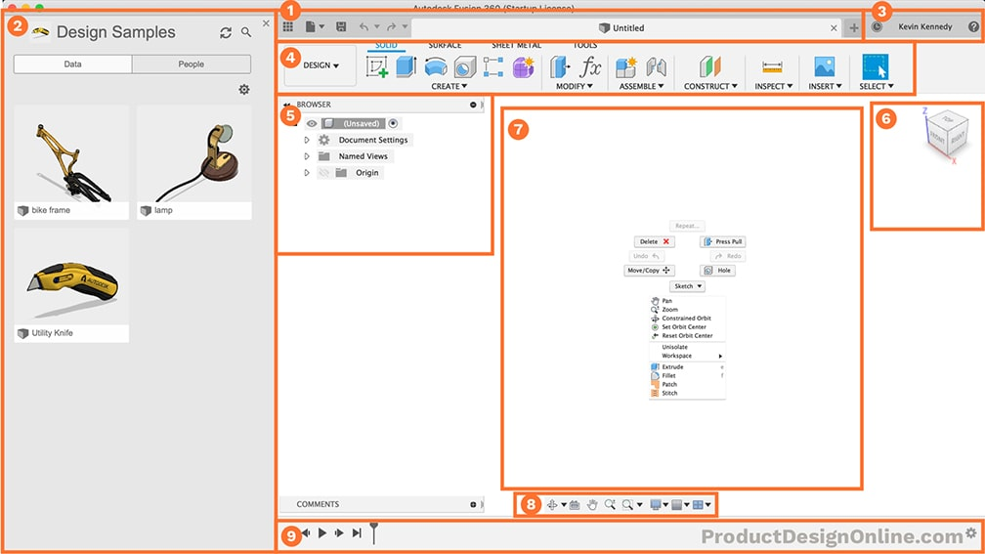
Basic functionality of Fusion 360
Application Bar
Data Panel
Profile and Help
Toolbar
Browser
ViewCube
Canvas and Marking Menu
Navigation Bar and Display Settings
Timeline

Slide 13
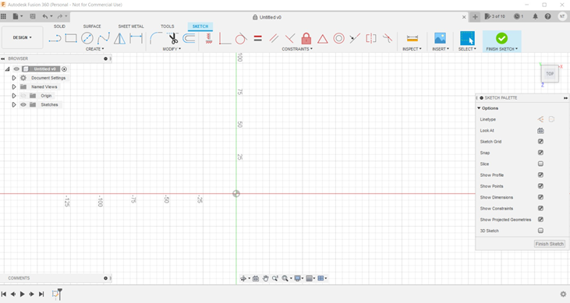
2D sketching
Line
Rectangle
Circle
Dimension
Fillet
Trim
Equal
Parallel
Perpendicular
Symmetry

Slide 14
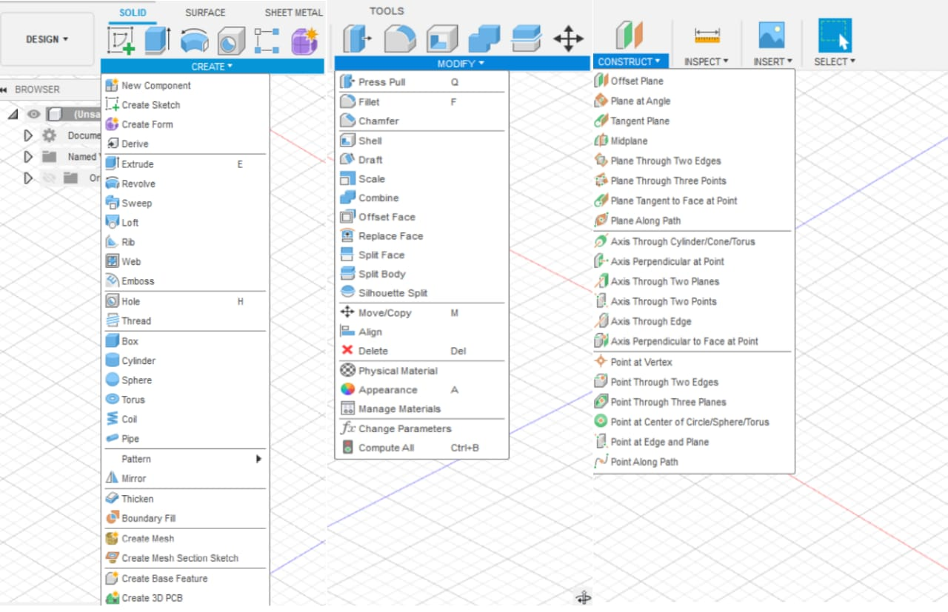
3D Modelling
Extrude
Revolve
Hole
Fillet
Chamfer
Sweep
Loft
Construct
Project

Slide 15
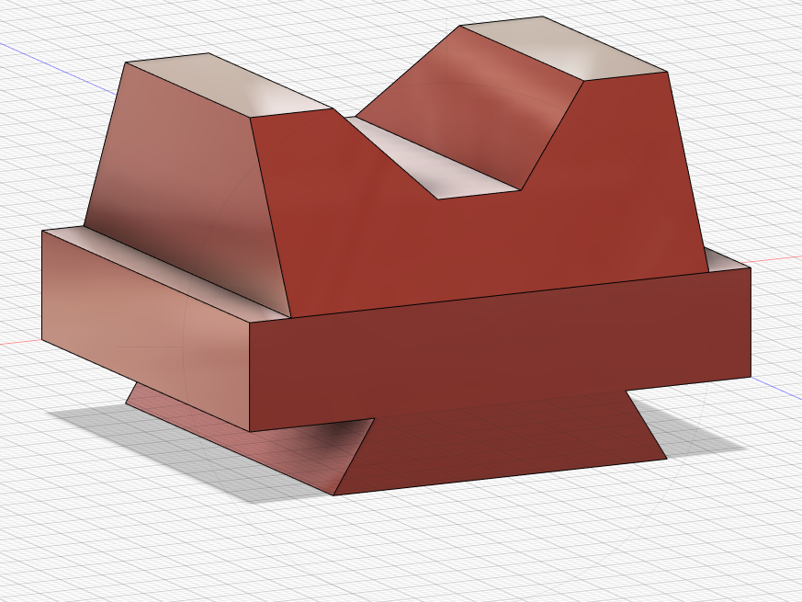
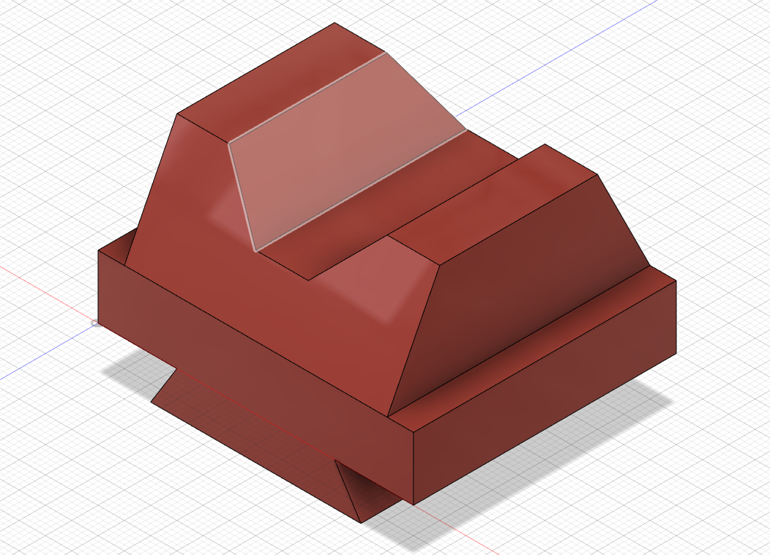
ASSIGNMENT
1

Slide 16
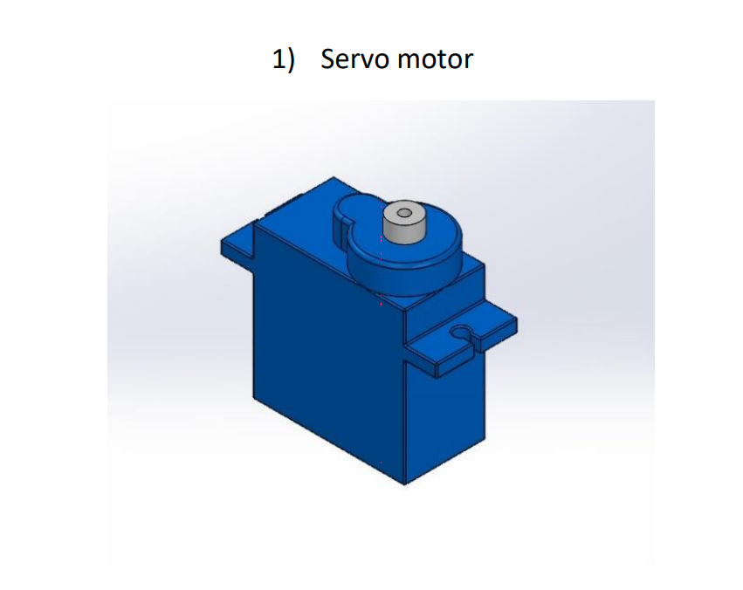
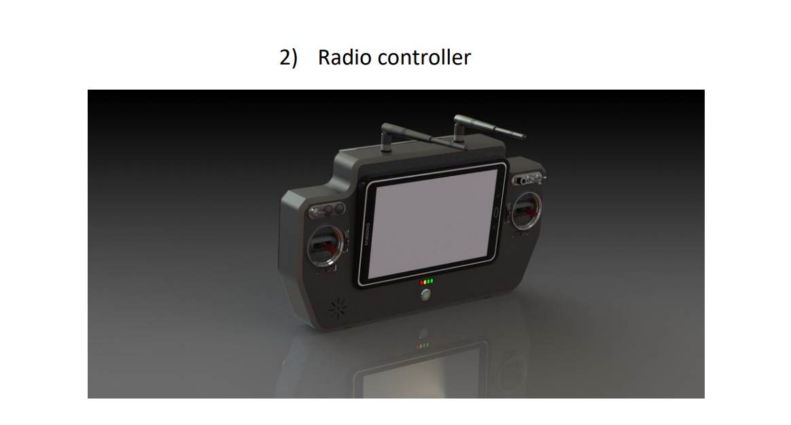
ASSIGNMENT
2

Slide 17

To be learned in the later part of the course
Airfoil DAT to spline
Form modelling
Designing airfoil in fusion 360
Fuselage, Empennage and Rendering
Basic plane modelling
Propeller Modelling

Slide 18
WEEK | CONTENTS
1 | Basics of Aeromodelling ,Download and basic of Fusion 360 software
2 | Basic features in fusion 360
3 | Drawings in Fusion 360 and 3D modelling
4 | 3D modelling in Fusion 360
5 | Import of Airfoil data ,design wings and propeller in Autodesk
6 | Design of fuselage
7 | Design of empennage of aircraft
TIMELINE

Slide 19

Aman Kumar Singh
Abhiyanshu Kumar
Aastha Sitpal
Ashish Sharma
Anukriti Singh
Aryan Raj
Kritika Bansal
Baishali Das
Naveen Teja
Preeti Kumari
Keyur Panchal
Padma Ram Rahar
Priya Satwika
Prakhar Gupta
Shubham Kumar
Rohit Chaudhary
Rahbar Shakeer
Vasu Paliwal
Shivangi
Sushma

Slide 20
THANK YOU
CAD Designing

